Slide 1
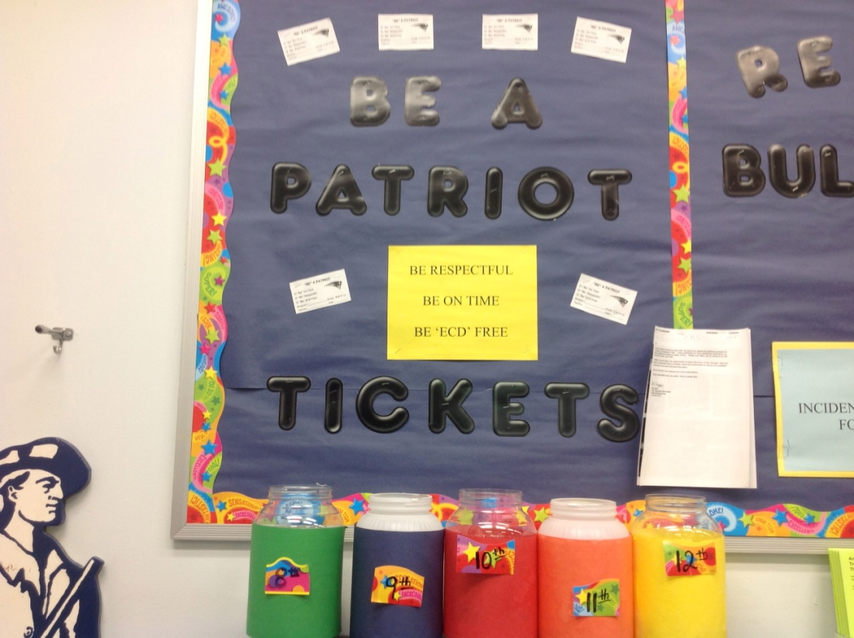
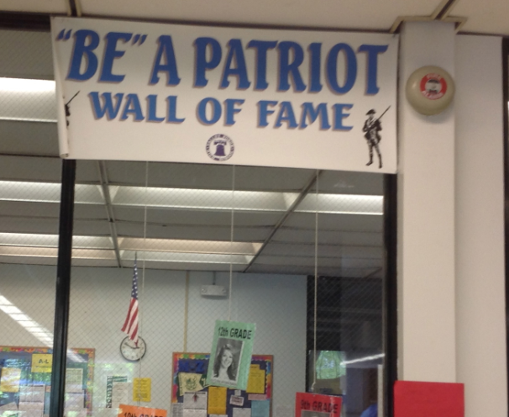
Grade Level Reward System
VALLEY FORGE HIGH SCHOOL
Wall of Fame

