Slide 1
Teaching Behavioral Expectations
Major components of this presentation were developed by: George Sugai and Rob Horner Of OSEP’s Technical Assistance Center www.pbis.org
In Conjunction with Iowa Behavioral Alliance (An Initiative of the Iowa Dept. of Education) www.rc4alliance.org

Slide 2
Session Goals
Review critical features related to teaching behavioral expectations
Notes:
You can see from the goals we have set out for this afternoon that planning heads the list. If
your PBS efforts are going to be successful It’s important for your team to have a long range
plan to help you organize your tasks. We have all been in situations where lack of planning
left us in a bad spot. Show next two slides.

Slide 3
School-wide expectations
What are your 3-5 positively stated memorable expectations?
Notes:
Ask large group to share these. 3-4 minutes for large group sharing and discussion.

Slide 4
School-wide expectations
Do you know what they mean?
Do your students know what they mean?
Notes:
Again, ask teams to take a few minutes to think about these two questions. Where are they in the process of defining expectations in different settings? Where are they in the process of developing teaching plans and a schedule for teaching? Use their answers as a guide to how much time to spend on next few slides.

Slide 5
Expectations, Belief statements
Where else do we have statements of expectations?
Church
Optimist Club
Boy Scouts
Court rooms
Military
Notes:
Having belief statements or expectations is not uncommon. Here are examples of similar expectations outside of the school.

Slide 6
Establish School-wide Discipline System
Define School-wide Behavioral Expectations
Teach School-wide Behavioral Expectation
Monitor and Acknowledge Appropriate Behavior
Use a Continuum of Consequences for Inappropriate Behavior

Slide 7
Establish School-wide Discipline System Action Steps
Actions:
Develop Teaching Matrix with faculty
Build Teaching Plans for school-wide expectations
Clarify responses to problem behavior
Notes:
Remind teams that they started their teaching matrix at the last training session.
Mention that there are packets on each table that contain samples of teaching plans
from other schools.

Slide 8
Establish School-wide Discipline System Action Steps
4a. Defining and Teaching School-wide Behavioral Expectations
Define 3-5, positively stated, memorable expectations.
Build Curriculum Matrix (Expectations By Settings)
Build Teaching Plans
Teaching individual Expectations across locations
Teaching all Expectations within a location

Slide 9
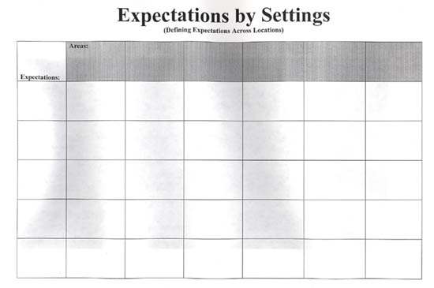
Expectations by Settings
Notes:
See handout file for copy of this

Slide 10
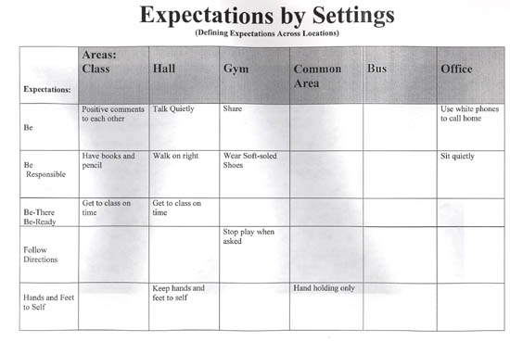
Sample Expectations by Settings

Slide 11
At Park Avenue, we are people of character. We are respectful. We are responsible. We care.
All Areas | Responsible | Respectful | Caring
 | Follow adult directions the first time Take responsibility for your words and actions | Use polite language and respectful voice Keep hands, body and objects to self | Treat others the way You want to be treated Keep Park Avenue clean, safe, & healthy
Cafeteria | Get all food and utensils 1st time Keep area neat and clean Raise hand and wait for permission to leave | Use line basics when entering Keep place in line Take the first milk you touch | Use good manners
Hallway | Go directly to where you need to go Carry hall pass | Walk on right side unless otherwise directed Use line basics when entering building | Wait for passing lines Hold doors for others
Playground | Use school equipment correctly and safely Follow Park Avenue game rules Line up immediately when bell rings Get permission to leave playground | Keep hands feet & objects to self Enter Building using line basics Use respectful language | Include everyone Try to solve problems appropriately Report injuries to a playground supervisor
Restroom | Take restroom pass and nothing else Use/flush/Wash/Leave | Keep restroom clean Respect the privacy of others | Wait quietly and patiently for your turn Report problems to an adult immediately
Notes:
Here is a sample of one prepared by Park Avenue in Des Moines.

Slide 12
Park Avenue Expectation Lesson Plan
At Park Avenue, we are people of character. We are respectful. We are responsible. We care.
Area: Cafeteria Time Allotted: 15-20 minutes
Materials needed: For script: trays, utensils, milk, napkins, buckets for silverware, garbage can, trays for
all students to practice for classroom teacher:
Expectations
Responsible | Respectful | Caring
Get all food and utensils 1st time Keep area neat and clean Raise hand and wait for permission to leave | Use line basics when entering Keep place in line Take the first milk you touch | Use good manners
Walk down the right side of the stairs quietly using the handrail one step at a time.
Enter cafeteria using line basics (Hands at sides, facing forward, voices off.)
Take the first milk you touch and hold it carefully in your hand.
Take the first utensil you touch.
Take your tray and say “thank you”.
Choose items and put them on your tray. Once you have touched something it’s yours.
Enter your number.
Go to the directed table and quietly eat your own lunch - no sharing.
Raise your hand and wait to be dismissed.
Put your utensils carefully into the tub.
Carry your tray carefully and throw out everything.
Stack your tray on the counter so it fits inside the others.
Leave the lunchroom quietly and walk to recess.
Notes:
Based on that information, Park Avenue then prepared this lesson plan.

Slide 13
McCombs Middle School Teaching Schedule
DATES | 6th Discover | 6th Explorer | Team 7 | Team 8
Monday 8/30 | 2 | 3 | 4 | 5
Tuesday 8/31 | 6 | 7 | 8 | 9
Wednesday 9/1 | 1 | 2 | 3 | 4
Thursday 9/2 | 5 | 6 | 7 | 8
Friday 9/3 | 9 | 1 | 2 | 3
Tuesday 9/7 | 4 | 5 | 6 | 7
Wednesday 9/8 | 8 | 9 | 1 | 2
Thursday 9/9 | 3 | 4 | 5 | 6
Friday 9/10 | 7 | 8 | 9 | 1
Teaching Areas:
1 -- Cafeteria 4 -- Restroom 7 -- Bus
2 -- Hallway 5 – Auditorium 8 -- Office
3 -- Outside 6 -- Before/After 9 -- Rewards
Notes:
And this teaching schedule.

Slide 14
15 Minute Activity
In groups, work on the matrix for your school with the sheets provided at your tables.
Notes:
Teams will likely be at different levels of development. This is a good opportunity to
rotate around the room and check on team status and help teams if needed.
Adjust the time and activity based on where teams are in terms of
development and understanding.

Slide 15
Teaching expectations
Create a plan to teach expectations throughout the school.
Use the language of school-wide expectations, for example, “Is it being respectful when you are noisy in the hall, or is it responsible when you leave a mess in the lunchroom?”

Slide 16
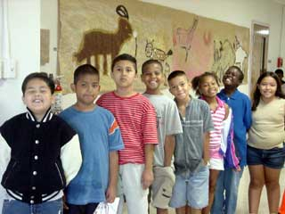
Teaching expectations
What are some ways that you can teach the specific expectations around your school to all students and staff?
Notes:
Trainer: Consider having some samples from schools in the area who have been doing this for a couple of years.

Slide 17
Teaching expectations
Have students, in groups, rotate to designated areas of the school where staff demonstrate the positive and negative examples of specific expectations in that area.
Use video examples.
Have students make posters.
Use an all school assembly.
Have students generate the matrix.
Notes:
Trainers give examples. Also, refer to packets at each table.

Slide 18
Teaching Expectations
Have students create skits.
Have students write letters to their parents or articles for the school newspaper about expectations.
Play “Pictionary” with expectations.
Create student-made books.
Have students self evaluate….

Slide 19
Teaching expectations
In your team, discuss how you have or plan to teach behavioral expectations to your students and staff?
Notes:
Again, refer to ideas in the packets at each table. Allow some time for discussion, based on your knowledge of their need. Then ask a couple of teams to share.

Slide 20
Don’t forget . . .
The positive!

Slide 21
Positive Reinforcement Guidelines for Effective Praise
State the appropriate behavior
Provide praise immediately
Vary statements of praise
Avoid giving praise continually without reason
Be sincere, smile
Notes:
Positive reinforcement in the form of verbal praise can have a powerful effect on behavior.
Verbal praise is something most of us feel we “can do” without much thought or
deliberate thought. However, in order for verbal praise to serve as a
positive reinforcer, there are important points to remember: • often includes student’s name
• be specific - describe what the student is doing at the time - focus on action

Slide 22
Remember. . .
The key to PBS is both our behavior as adults and student behavior.

Slide 23
Basic Management Practices
Active supervision
Movement
Scanning
Interactions
Pre-corrections
Positive reinforcement of expected behavior
Notes:
Trainers: Share examples from your own work here.

Slide 24
Why does everyone need to be involved?
Staff outnumbered in too many settings
Adult presence
Prompts desired behavior
Deters problem behavior
“Being a good citizen”
Contribute to school climate

Slide 25
Talk, Walk, Squawk
An elementary school principal found that over 45% of their behavioral incident reports were coming from the playground.
Notes:
Optional slide:
Talk, walk and squawk is a component of PBS’s response to bullying behavior.
This was a program to teach kids to deal with bullying. Tell them an appropriate saying to indicate they are to stop what they are doing (Example: Put up hand and say “stop’)
Walk away from the confrontation if it doesn’t stop
Report to appropriate school personnel

Slide 26
Team Activity
In your handout packet, is a Non-Classroom Setting Self-Assessment Checklist.
Notes:
Trainers: Ask them to pull this out and have them review so they know they have this tool.

Slide 27
Summary
Expectations
Goal of expectations
How to design expectations
Sample expectations

