Slide 1
Notes:
The behavior matrix defines what each of the clear expectations look like and sound like in each location/setting. In developing the matrix, it’s helpful to think about what adults in the setting are most frequently correcting students about/for. Then, turn these into what you want the students to be doing instead. It’s helpful to start with a verb.The matrix defin

Slide 2
Spinning Hills Positive Behavior Support
Area | Be Respectful | Be Responsible | Be a Problem Solver | Be Trustworthy
Hallway | *Respect others’ personal space and property *Maintain appropriate distance *Be quiet *Keep hands, feet & objects to yourself *Use appropriate language | *Walk behind teacher/leader in single file as directed *Eyes forward *Go directly to destination *Have a pass | *Think before you act *Report serious problems to staff/teachers *If in a disagreement with peer, walk away *Avoid looking at or paying attention to distractions | *Be truthful *Do what’s right, even when no one is watching *Get materials and go back to class immediately
Cafeteria | *Use inside voice *Be polite and use good manners to peers and staff *Keep hands, feet & objects to yourself *Use appropriate language | *Have money/ID ready *Carefully dispose of trays *Clean up area *Walk to assigned table *Stay seated until finished | *Think before you act *Report serious problems to staff/teachers *If in a disagreement with peer, walk away *Avoid looking at or paying attention to distractions | *Be truthful *Report problems to staff/teachers *Pay for all items *Stay in place in line *Do what’s right, even when no one is watching
Restroom | *Give privacy to others *Use facilities and supplies correctly *Wait your turn quietly *Use inside voice *Keep hands, feet & objects to yourself *Use appropriate language | *Wash hands and clean up after yourself and others *Inform teacher of any facility problem *Use facilities in a timely manner | *Think before you act *Report serious problems to staff/teachers *If in a disagreement with peer, walk away *Avoid looking at or paying attention to distractions | *Be truthful *Use restroom only when needed and for the correct purpose *Do what’s right, even when no one is watching
Arrival/ Breakfast | *Keep hands, feet & objects to yourself *Use appropriate language *Enter building quietly *Use inside voice *Be polite and use good manners | *Put belongings in assigned area *Walk directly to cafeteria *Be in classroom on time *Stay seated in the gym until dismissed by the staff *Follow hallway rules | *Think before you act *Report serious problems to staff/teachers *If in a disagreement with peer, walk away *Avoid looking at or paying attention to distractions | *Be truthful *Report problems to staff/teachers *Finish your breakfast in the cafeteria *Get materials and go back to class immediately *Do what’s right, even when no one is watching
Dismissal | *Use appropriate voice *Be silent during announcements *Be patient when waiting to board the bus *Keep hands, feet & objects to yourself *Use appropriate language | *Leave when dismissed by teachers *Walk behind teacher/leader in single file as directed *Walk to bus/car using the sidewalk/steps | *Think before you act *Report serious problems to staff/teachers *If in a disagreement with peer, walk away *Avoid looking at or paying attention to distractions | *Be truthful *Do what’s right, even when no one is watching *Get materials and go back to class immediately
Notes:
It’s critical to make sure that adults model the expectations as defined in the matrix. For example, Use an Inside Voice, can mean different things to different students, families, and staff. Staff will do well to define Use and Inside Voice so that it is consistently modeled for students and prevents the cultural mismatch of inside voice between school and home cultures.

Slide 3
Behavior Matrix
Respect
Responsibility
Focus
Self-Control
Problem-Solving
Hallway
• Walk
• Hands/feet to self
• Silent
• Maintain appropriate space/distance
• Walk on right side
• Be in line
• Be in order
• Have a pass
• Eyes forward
• Stay in line
• Stay in order
• Silent
• Hands/feet to self
• Listen
• Find the right time
• Walk
Cafeteria
• Talk when allowed
• Silent in line
• Food stays in cafeteria
• Eat only own food
• Take first seat
• Keep space clean
• Enter/exit orderly
• Have money/lunch card
• Carry tray with two hands
• Use time to eat
• Have money/lunch card
• Carry tray with two hands
• Stay seated
• Raise hand if you need something
• Food stays in cafeteria
• Eat only own food
• Walk
• Get everything you need when you go through the line
Playground
• Take turns/wait your turn
• Keep hands, feet, objects to self
• Speak to/treat others kindly
• Take care of equipment
• Follow signals
• Play cooperatively
• Accept consequences
• Play safely
• Ask for help
• Line up at signal
• Store and use equipment properly
• Follow directions
• Pay attention to surroundings
• Use equipment appropriately
• Keep a safe distance
• Stay in assigned area
• Stand quiet and still when recess is lost
• Keep hands, feet, objects to self
• Keep a safe distance
• Avoid conflict
• Speak appropriately
• Accept consequences
• Use strategies (i.e. rock, paper, scissors)
• Think before you act
• Talk through disagreement
• Play cooperatively
• Seek help
• Be peaceful
Miami Valley SERRC, 2006
Notes:
Matrices should be unique and a match for the culture of the school community. Engaging the team and staff colleagues in defining the expectations to develop the matrix is an important step in the process for buy-in and an effective tool for teaching expectations.

Slide 4
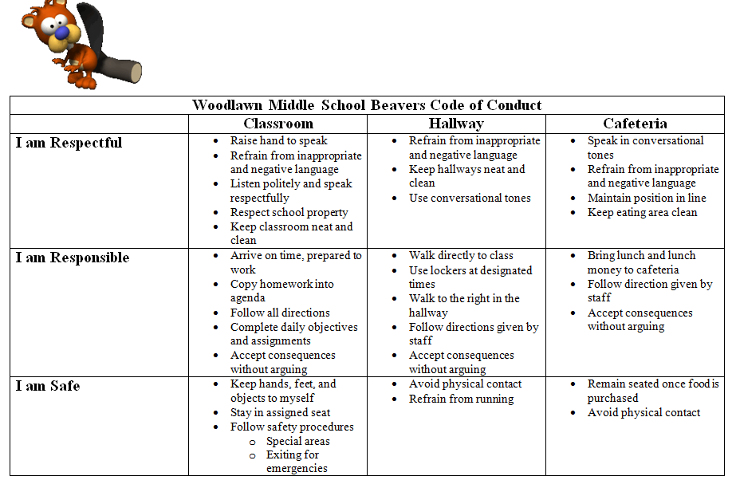

Slide 5
